Slide 1
Cyclistic
How do annual members and casual members
use Cyclistic bikes differently?
Prepared by: Michele Jean-Louis
Last updated: October 11, 2023

Slide 2


Slide 3
Business Task
Cyclistic is a fictional bike-share company in Chicago. The company wants to maximalize the number of annual memberships and therefore wants to understand how do annual members and casual riders use Cyclistic bikes differently?
My insights will help the marketing team design marketing strategies aimed at converting casual riders into annual members.
Key Stakeholders
Lily Moren, director of marketing and manager
Cyclistic executive team

Slide 4
Data source
The data has been made available by Motivate International Inc. under the divvybikes.com data license agreement.
The data is organized by trip by quarter up to 2020 and then we get monthly data files up to July 2023. For each trip, we have the start and end time, the bike ID, the bike type, the starting location and ending location (with latitude and longitude) and the user type (casual or member).
There doesn’t seem to be any issues with bias or credibility in this data. The data is reliable, original, comprehensive, current and cited.

Slide 5
DATA CLEANING AND MANIPULATION
Formatted the started_at and ended_at columns
Created a column trip_duration by subtracting started_at from ended_at
Removed the negative trip_durations
Filtered out duplicate ride_id
Removed the entries with no station info
Created a calculated field for trip_durations in minutes

Slide 6
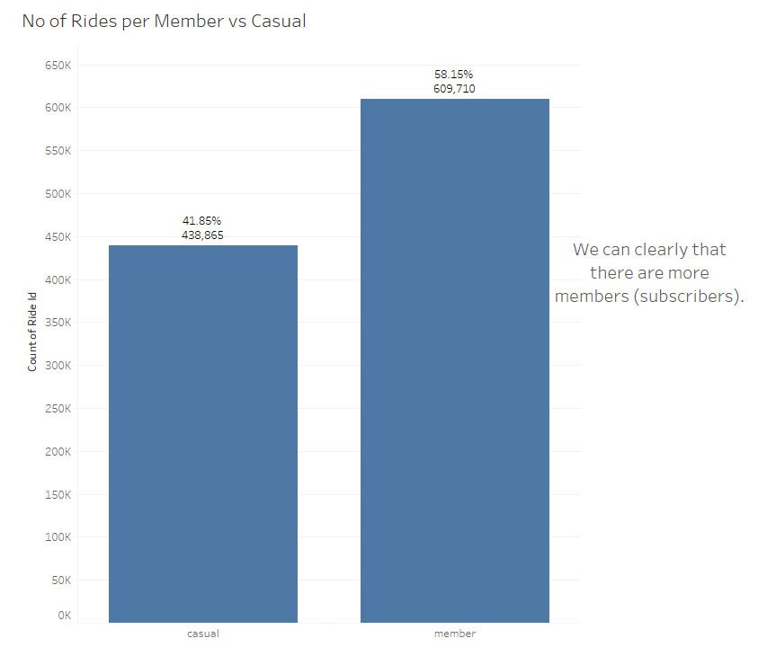

Slide 7
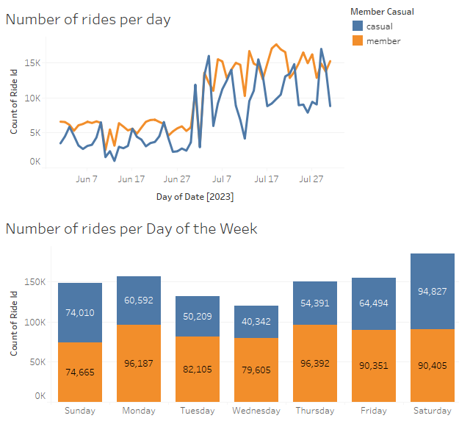
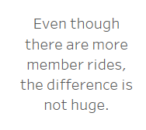
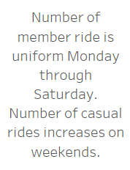

Slide 8
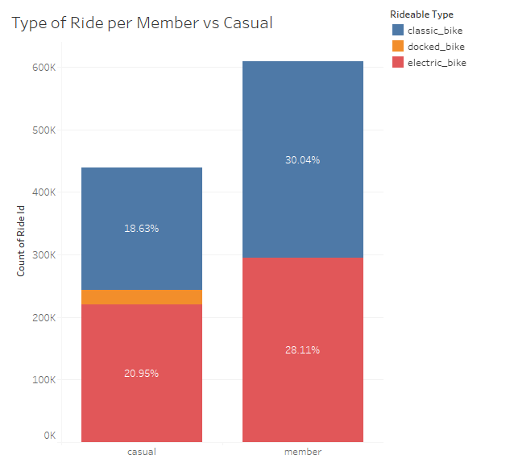
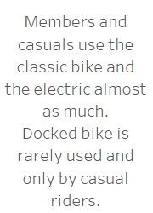

Slide 9
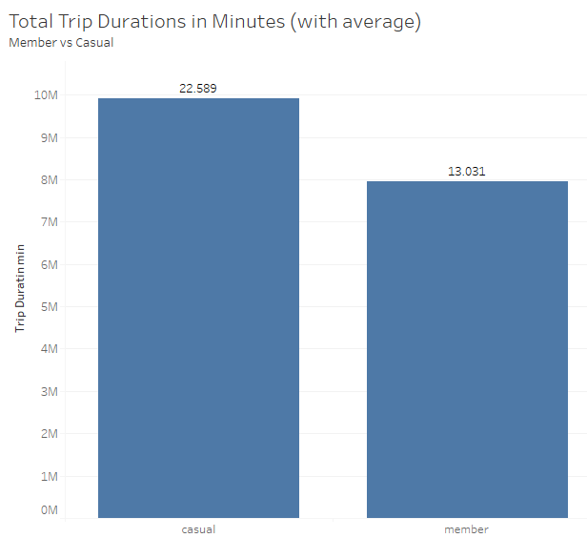
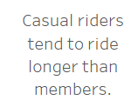

Slide 10
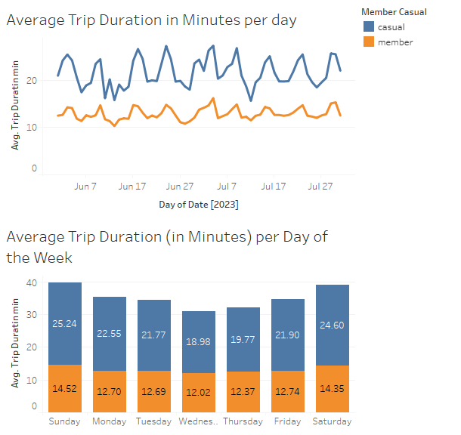
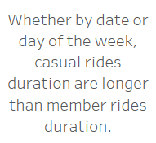

Slide 11
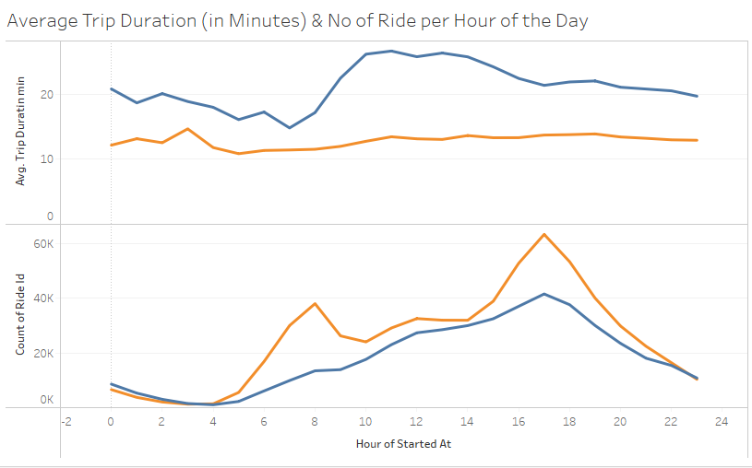

The average trip duration is uniform for members throughout the data, but for casual riders the length of trips increase between 9AM and 5 PM.
There is a peak in the number of rides for members at 8AM and 5PM which would indicate commute to and from work.
For casual riders, the number of rides increases linearly from 5AM to 5PM and then decreases.

Slide 12
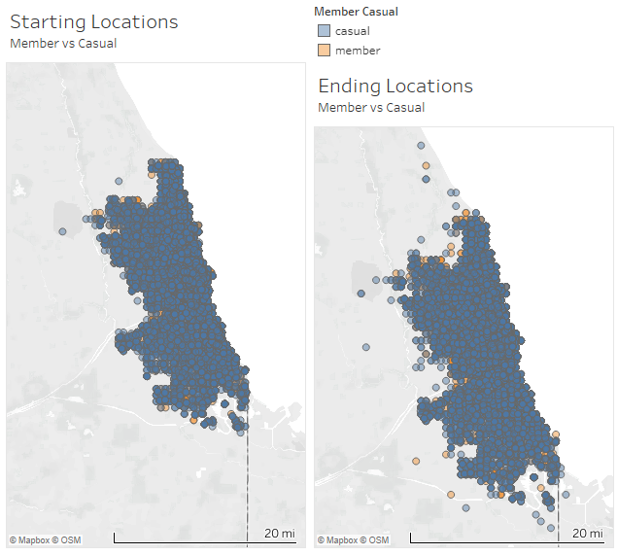
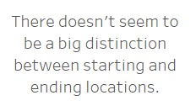

Slide 13
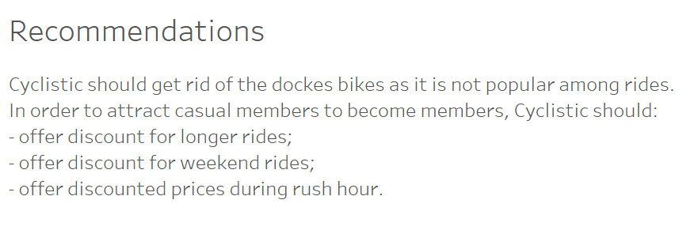
Cyclistic can create marketing campaign geared towards weekend riders and commuters.

Slide 14
References
Tableau Dashboard: https://public.tableau.com/app/profile/michele.jean.louis/viz/Cyclistic_16961906044630/Cyclistic?publish=yes
GihHub: https://github.com/michelejl/Cyclistic
Linkedin: https://www.linkedin.com/in/michelejeanlouis

